Slide 1

Image processing based Tracking, Counting and Speed Measure in vehicles
ABES Engineering College, Ghaziabad, UP
Department of CSE-AIML
Project Presentation
Project Domain: Data Science
Project Group No: CSE-AIML24-B11
Project guide: Ms. Kanika MALIK
Team members: Shruti DHIR(113)
Suhani Gupta (117)
Sheetal Sharma(9005)

Slide 2
Contents
Introduction
Proposed Methodology
Practical Implementation of Modules of project
Suggestion for Betterment
Constraints
Future Scope
Conclusion

Slide 3
Introduction
In this we will discuss about the car identification and tracking, counting and speed measuring in a selected region of interest with most accurate results. Vehicle detection ,counting and speed measure plays an important part of many systems that help to manage ,control traffic and help to manage speed limit on the road in the cities. We our to detect , count and measure speed for the cars with maximum accuracy and able to do so on roads, highways ,parking areas and in small lanes etc.

Slide 4
Proposed Methodology
An overview of the proposed methodology is shown in figure. It consists of various phases: preprocessing, vehicle detection and tracking and speed estimation. In the first phases, captured video is preprocessed for further processing. In the second phases, moving vehicles are extracted from background subtraction and other techniques. The third phase estimates the speed of detected vehicles and finally estimated speed along with their timestamps are stored in the database for future reference.

Slide 5
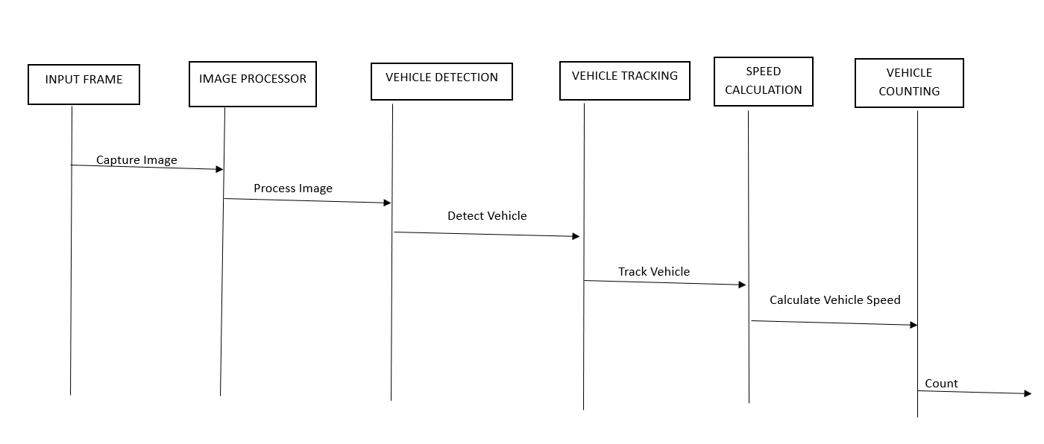

Slide 6
Practical Implementation of Modules of project
Practical implementation of a project involving image processing-based tracking and counting of vehicles typically involves breaking down the project into modules or components. Each module serves a specific purpose and contributes to the overall functionality of the system. Here's a step-by-step breakdown of practical modules for such a project:
Data Collection Module:
Obtain a dataset of images or video footage containing vehicles in a real-world setting. This dataset will be used for training and testing your tracking and counting system.
Data Preprocessing Module:
Preprocess the dataset to ensure it is suitable for training. Common preprocessing steps include resizing images, normalizing pixel values, and annotating objects of interest (vehicles).
Object Detection Module:
Train or use pre-trained object detection models to identify and locate vehicles in the images or video frames. This module should output bounding boxes around detected vehicles.

Slide 7
Practical Implementation of Modules of project
Object Tracking Module:
Implement object tracking algorithms to track the identified vehicles across multiple frames. This module should link objects over time to maintain a count.
Vehicle Counting Module:
Develop an algorithm to count the vehicles based on the tracking data. You may use techniques like line crossing detection, region of interest (ROI) analysis, or a combination of both to count vehicles as they enter and exit specific areas.
Speed Calculation Module:
We have to identify each vehicle in the video and then find their corresponding distance covered in consecutive frame.
Speed=Distance/Elapsed Time
Data Storage Module:
Store the tracking and counting results in a database or a structured format for further analysis and reporting.

Slide 8
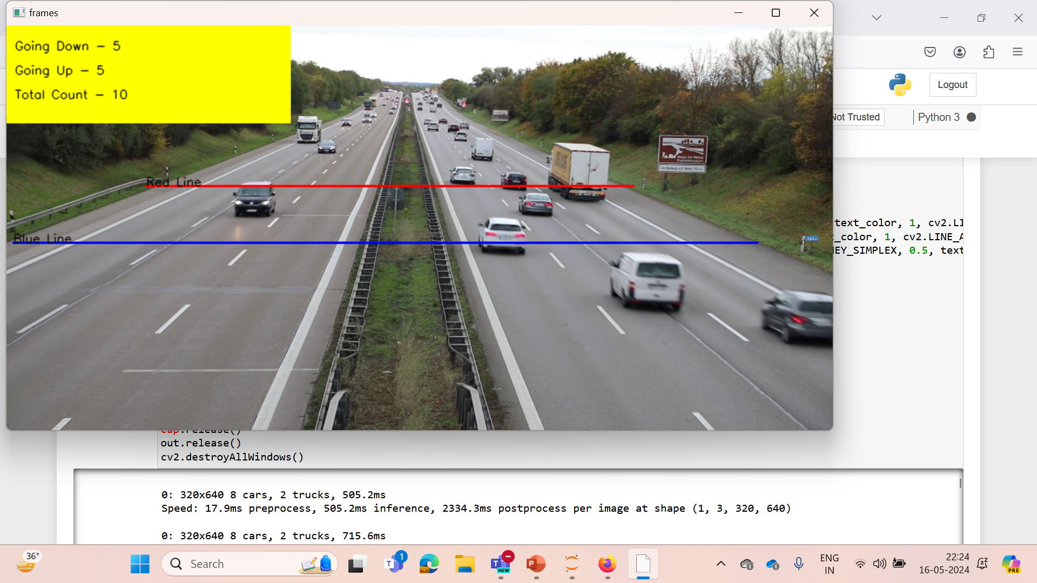

Slide 9
Suggestion for Betterment
Improving image processing-based tracking , counting and speed measures of vehicles can be achieved through the integration of various techniques. Here are some suggestions that encompass different approaches:
Hybrid Detection Models:
Combine multiple object detection models, such as YOLO (You Only Look Once) and Faster R-CNN (Region-based Convolutional Neural Network), in an ensemble. This can enhance detection accuracy by leveraging the strengths of different models.

Slide 10
Suggestion for Betterment
Background Subtraction:
Apply background subtraction techniques to extract moving objects from the scene. This can help in identifying and tracking vehicles against a stationary background.
Semantic Segmentation:
Integrate semantic segmentation to distinguish different classes of objects in the scene, allowing for more accurate identification and tracking of vehicles.

Slide 11
Constraints
1. Image captured in night and other low circumstances
2. Vehicle Occlusion and traffic jam in the scene
3. Too slow/fast vehicles
4. Unstable camera’s field of view
5. Different View of vehicles

Slide 12
Future Scope
1. Enhanced Safety and Emergency Response: Vehicle tracking systems can play a critical role in enhancing safety and emergency response capabilities. First responders can quickly locate and assist vehicles involved in accidents or emergencies based on real-time tracking information.
2. Real-Time Traffic Management: Improved vehicle tracking will enable real-time traffic management systems. Transportation agencies can use this data to identify congestion hotspots, implement dynamic routing strategies, and improve the efficiency of public transportation networks.

Slide 13
Future Scope
3. Privacy and Security Considerations: As vehicle tracking technologies become more prevalent, addressing privacy concerns and ensuring data security will be crucial. Regulations and industry standards will need to be established to protect consumer privacy and prevent unauthorized access to sensitive tracking data.
4.Autonomous Vehicle Navigation: Vehicle tracking technologies are essential for the safe navigation of autonomous vehicles. These vehicles rely on accurate real-time data about surrounding traffic conditions to make informed driving decisions.

Slide 14
Conclusion
In conclusion, image processing techniques offer a robust and efficient solution for tracking, counting, and measuring speed in various applications. By leveraging algorithms such as object detection, motion tracking, and optical flow analysis, image processing systems can accurately detect and track objects of interest in real-time. This capability enables automated counting of objects in scenarios like traffic monitoring, retail analytics, and industrial production lines.

Slide 15
Thank You !

